Slide 1
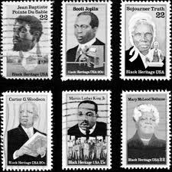

Rethinking Theory in Black Studies:
#3 HISTORY
Abdul Alkalimat
University
of Illinois
Black History Month stamps

Slide 2

Lecture 1: IDEOLOGY
The ideological framework
Identity
Analysis
Commitment
Program
Action

Slide 3

Lecture 2: Methodology
The D-7 Method
D1: Definition
D2: Data
D3: Digitization
D4: Discovery
D5: Design
D6: Dissemination
D7: Difference

Slide 4



Lecture 3
What is history? What
has been the history of the
African American experience?
Can we create a theory
of Black history? Yes, and
here’s how.

Slide 5
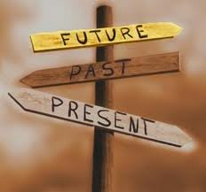
What is history:
Who writes it?
Who publishes it?
Who reads it?
So what?
History is written in the present about
the past to help create a future.

Slide 6

Charles Tilly
(1929 – 2008)
“The word history refers to a
phenomenon, to a body of material,
and to a set of activities. As a
phenomenon, history is the
cumulative effect of past
events on events of the present—any present you care
to name. To the extent that when something happens
matters, history is important.…As a body of material,
history consists of the durable residues of past
Behavior….What of history as a set of activities? The
central activity is reconstructing the past.” (1981)

Slide 7
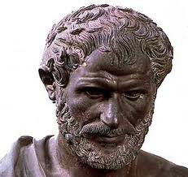
Aristotle (384 – 322 BC)
The races that live in cold regions and those of Europe are full of courage and passion but somewhat lacking in skill and brain power; for this reason, while remaining generally independent they lack political cohesion and the ability to rule others. On the other hand the Asiatic races have both brains and skill but are lacking in courage and will power; so they have remained both enslaved and subject. The Hellenic race, occupying a mid position geographically, has a measure of both. Hence it has continued to be free, to have the best political institution and to be capable of ruling others given a single constitution. (Politics 7.7)

Slide 8

Grand world history and Africa?
Eurocentric ignorance masquerading as
knowledge in distorting world history
Oswald Spengler (1880-1936)
Decline of the West, 2 volumes
H.G. Wells (1866-1946)
The Outline of History, 3 volumes
Arnold J. Toynbee (1889-1975)
A Study of History, 12 volumes
Will Durant (1885-1981)
The Story of Civilization, 11 volumes

Slide 9
Basic tenets of “Eurocentrism”
Reason has its origin in Ancient Greece.
Capitalism could only have developed in Europe.
Christianity is superior to all world religions.
European cultural values are the best.
“White” people are destined to rule the world.

Slide 10

Critique of Eurocentrism
Karl Marx (1818-1883)
Capital, 3 volumes
Fernand Braudel (1902-1985)
Capitalism and Material Life, 3 volumes
James Blaut (1927-2000)
Trilogy on Eurocentrism, 3 volumes
Edward Said (1935-2003)
Orientalism, 1 volume

Slide 11
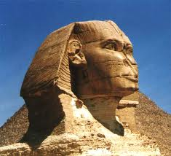
Basic CRITIQUE of “Eurocentrism”
Reason has its origin in Ancient Greece.
...Ancient Greece learned from Egypt (Africa)!
Capitalism could only have developed in Europe.
...Capitalism is not unique to Europe!
Christianity is superior to all world religions.
...All gods work the same way!
European cultural values are the best.
...Black is beautiful!
“White” people are destined to rule the world.
...The sun sets on all empires!

Slide 12
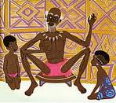

When history meets sociology:
Historical specificity
of a social narrative
Everybody learns
from a good story
Conceptual causality
of social change
Everybody wants
to know why

Slide 13
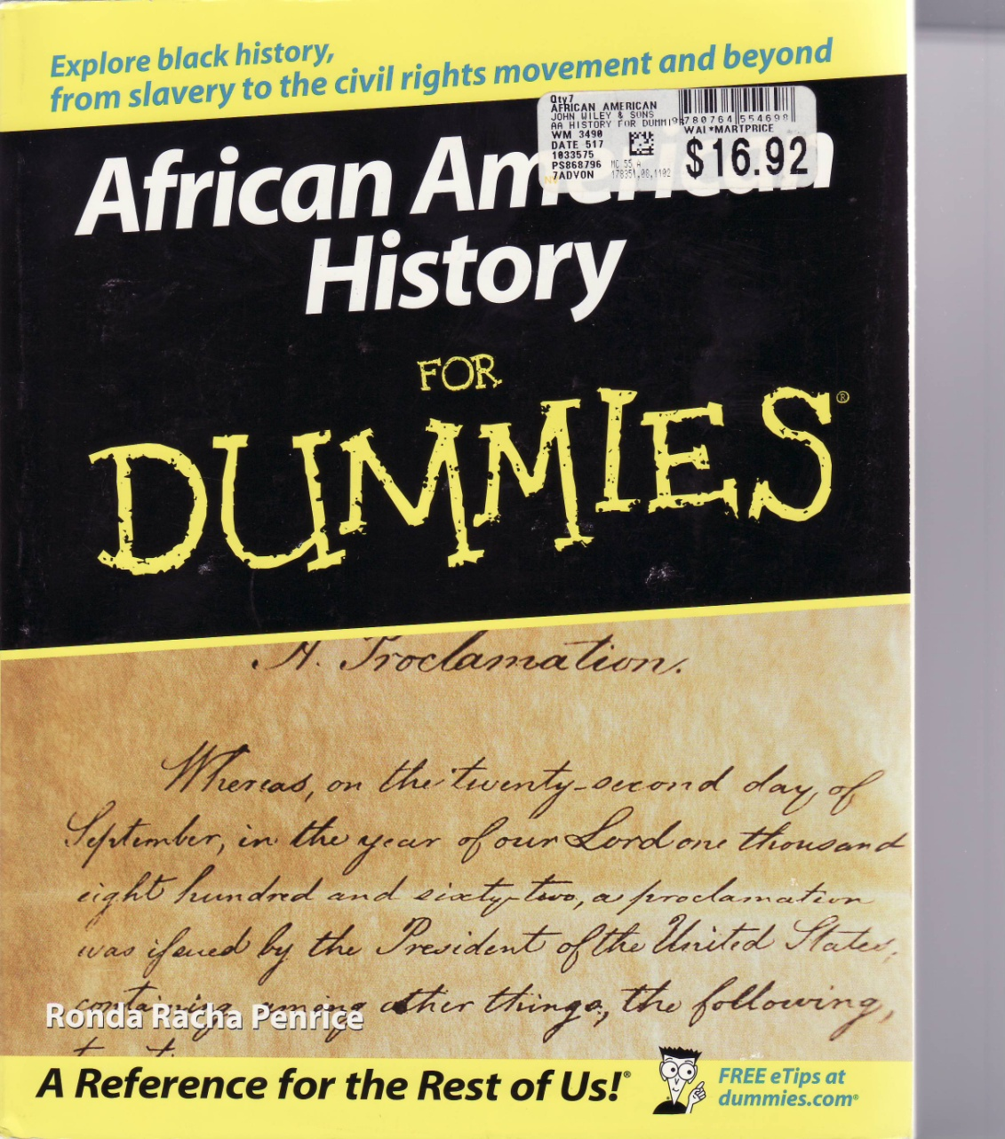
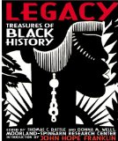


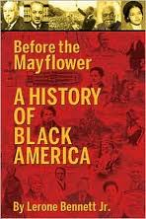
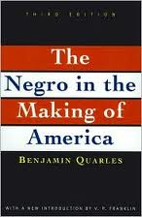
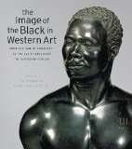

Slide 14
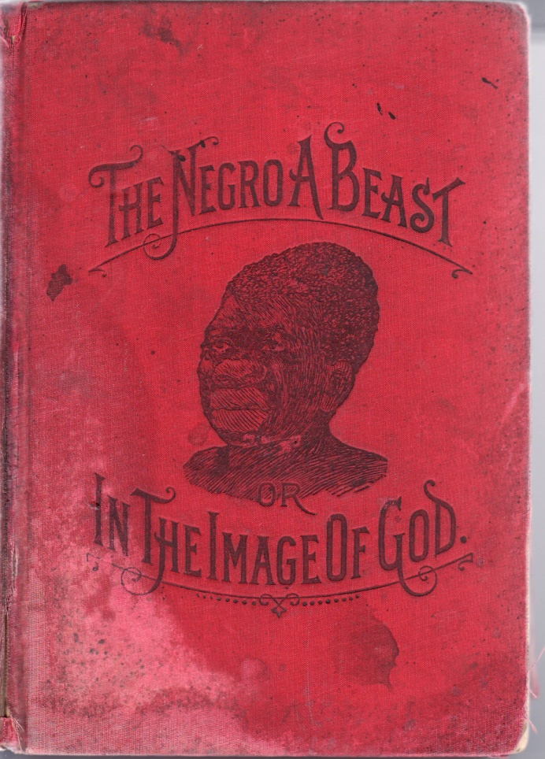

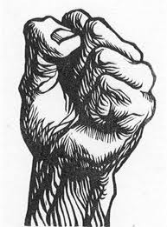
Three kinds of
History of Blacks
White history of Blacks
Black history of Blacks
Radical history of Blacks
This is a matter of
consciousness not
biology.

Slide 15
White history of Blacks: mainstream
dominated by racist neglect and lies
Frederick Turner, Harvard (1861-1932)
U. B. Philips, Yale (1877-1934)
Charles Beard, Columbia (1874-1948)
“Turner…was himself a racist…the Beardian
Perspective…lent itself to a pro southern
Interpretation” Meier and Rudwick 1986

Slide 16
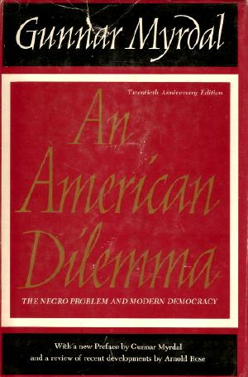
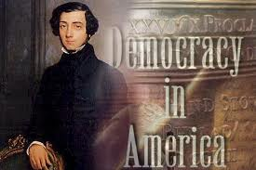
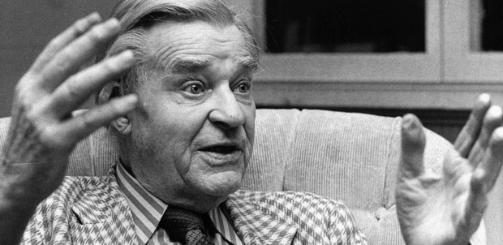
The liberal approach often
relied on a European view
Gunnar
Myrdal
1898-
1997
Alexis de Tocqueville
1805-1859

Slide 17
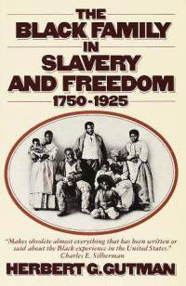
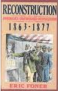

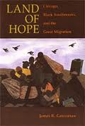


Progressive mainstream historians influenced
by the 1960s began mapping the historical
periodization of the Black experience
This was a new beginning

Slide 18
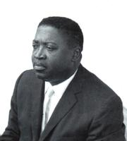
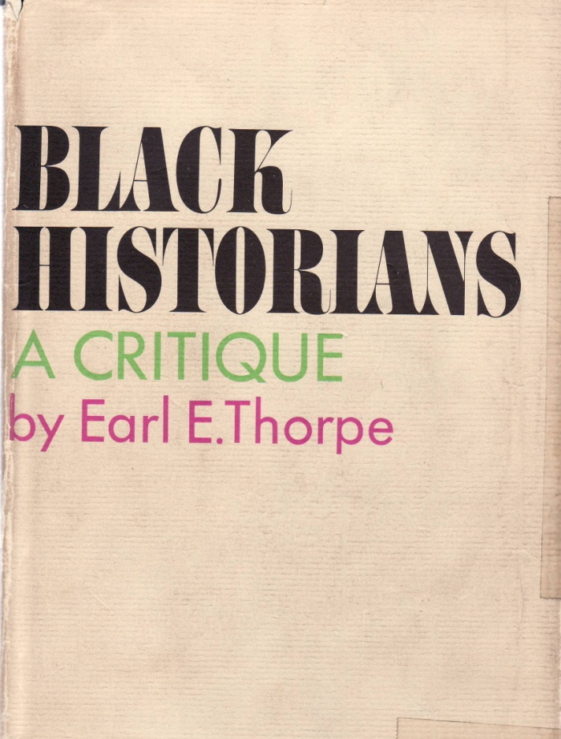
Earl Thorpe (1924 – 1990):
Why do we have a Negro
History Movement?
“historical writing has been slow
to shed its aristocratic tradition
and bias”
“to combat the prominence of
racial prejudice and stereotypes”
“to inspire Blacks to high
achievement.” (1958)

Slide 19
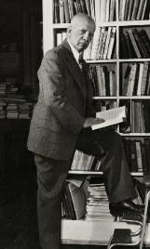
Father of Black History
Black History Month
Association for the Study of
Afro American Life and History
Journal of African American History
Associated Publishers
Leader of a school of Black historians
Published many books and articles
Carter G Woodson
1875 - 1950

Slide 20
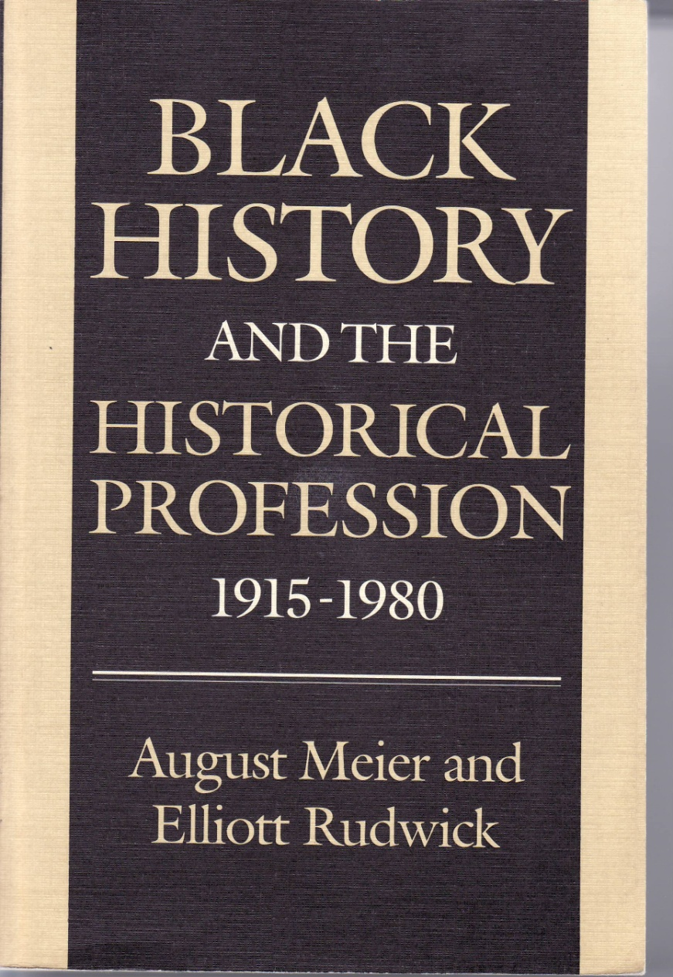


Five periods of Black Historiography
From ASALH to 1930s
New Deal and WW II
War’s end to late 1950s
1960s
New scholarship 1967-80

Slide 21


Robert Harris:
Five schools of Black
historiography
Revisionism
Hidden hand
Contributionism
Cyclical
Liberalism

Slide 22

Of all our studies, history is
best qualified to reward our
research. And when you see
that you’ve got problems,
all you have to do is examine
the historic method used all
over the world by others who
have problems similar to
yours. Once you see how
their got theirs straight, then
you know how you can get
yours straight.

Slide 23
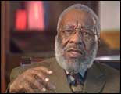
“…the main focus of Negro historiography presented only an indirect challenge to the essential
concepts of mainstream American historiography. It sought acceptance. Whereas, it seemed to me, those of us who were trying to create what we consciously chose to call Black history came out of the Black conscious movement, out of the Black struggles of the fifties, sixties, and early seventies. In our work, we were seeking…
to present a fundamental
challenge to the accepted truth
of white American society.”
Vincent Harding

Slide 24
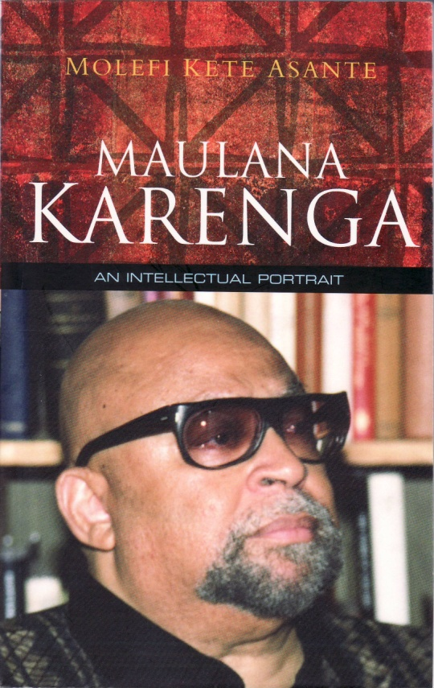

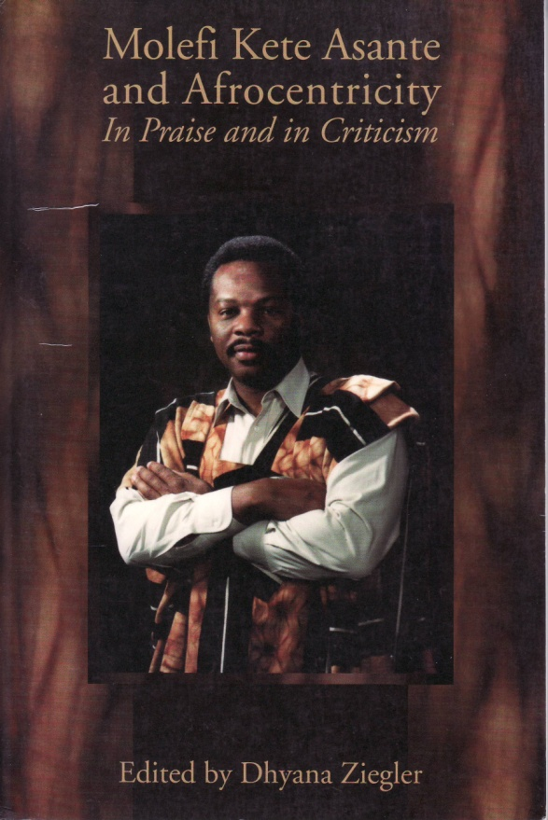

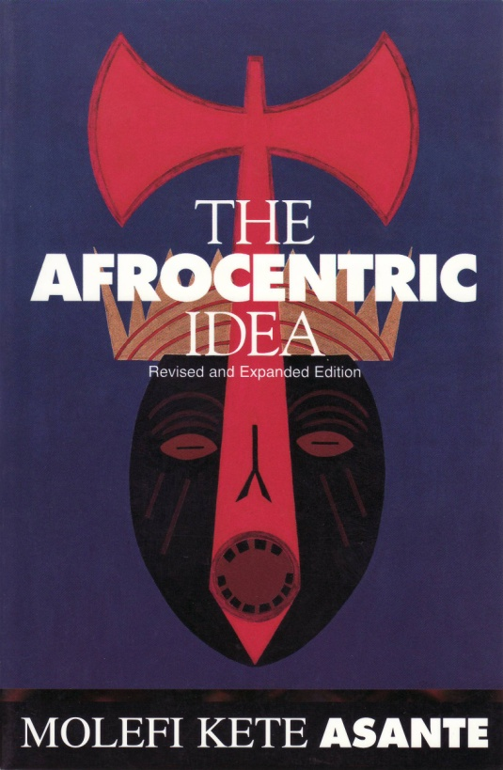

The refutation of
Eurocentrism was
advanced as Afrocentrism,
placing ancient Africa
as our main point of beginning.

Slide 25
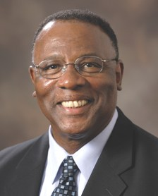
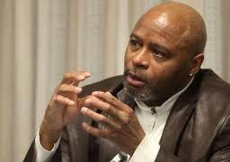

Ideological mission of Black Studies:
Academic excellence and social responsibility
UIUC Black historians are among the best representatives of
the Black Studies tradition of criticizing mainstream views
and finding a way to give priority to the Black voice. Here
James Anderson, Sundiata Cha Jua and Lou Turner are among
leaders of the sixth stage of Black historians. In our
class we are preparing anthologies of their theory work.

Slide 26
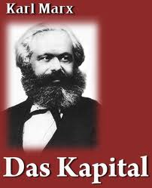
Radical Black history is found
within Marx
“…the turning of Africa into a
warren for the commercial hunting
of Black skins, signalled the rosy
dawn of the era of capitalist
production.”
“In the United States of America,
any sort of independent labor
movement was paralyzed so long
as slavery disfigured a part of the
republic. Labor with a white skin
cannot emancipate itself where
labor with a black skin is branded.”
1818-1883

Slide 27
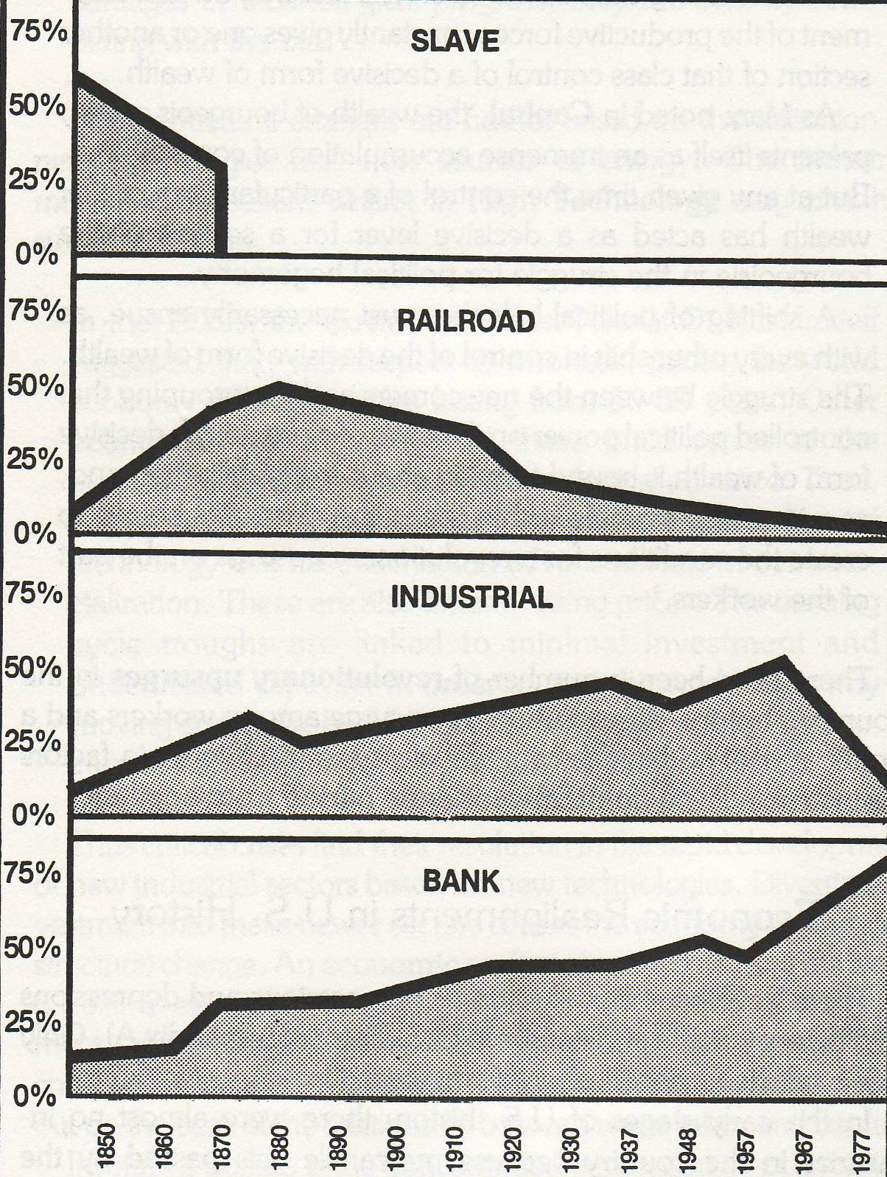
Capital concentration in the US economy
The main issue focuses on the
economic structure of the
country and how different
interests contest for power.
The US experience of the
workers versus the capitalists
has been impacted by the
unique experience of the
middle classes.
It is clear who rules!

Slide 28

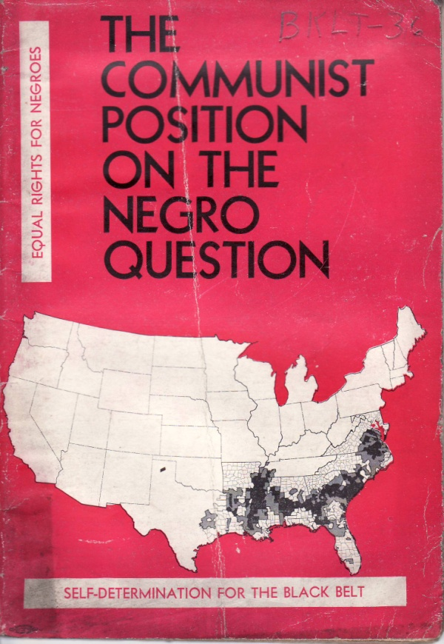

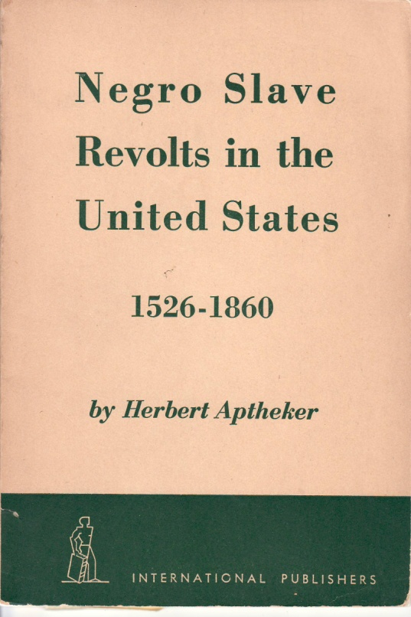
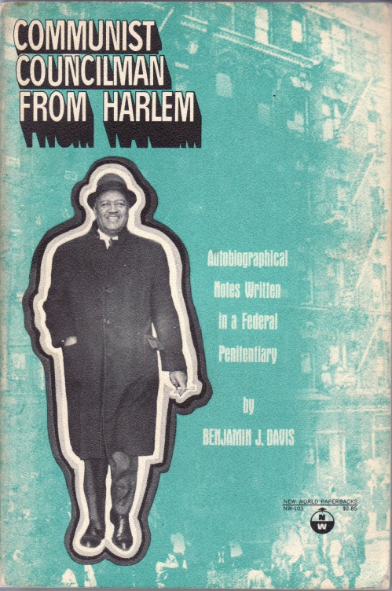
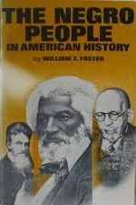
There is a Marxist
analysis of African
American history.
These texts are from
the “old” communists.

Slide 29
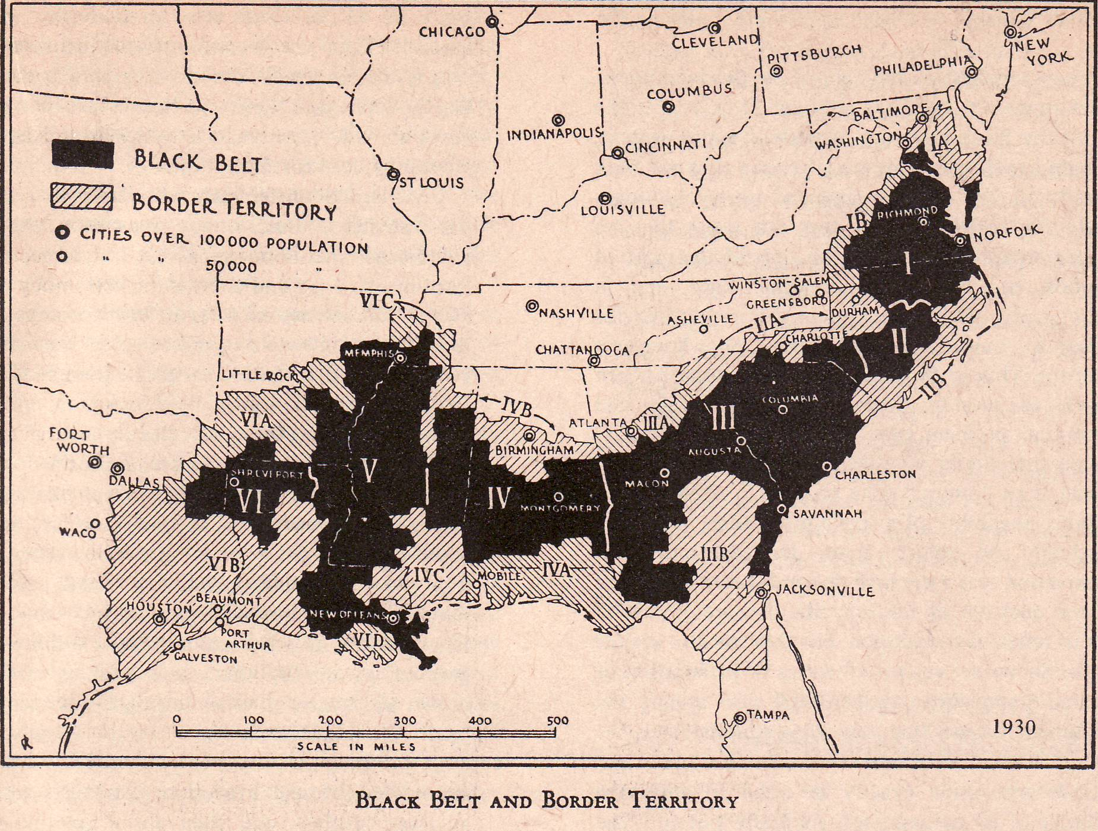
Black Belt Nation Thesis:
“A nation is an historically constituted, stable
community of people formed on the basis of a
common language, territory, economic life and
psychological make
up manifested in a
common culture.”
Was down “home”
a nation? Who was
In the nation?

Slide 30

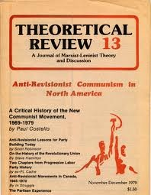
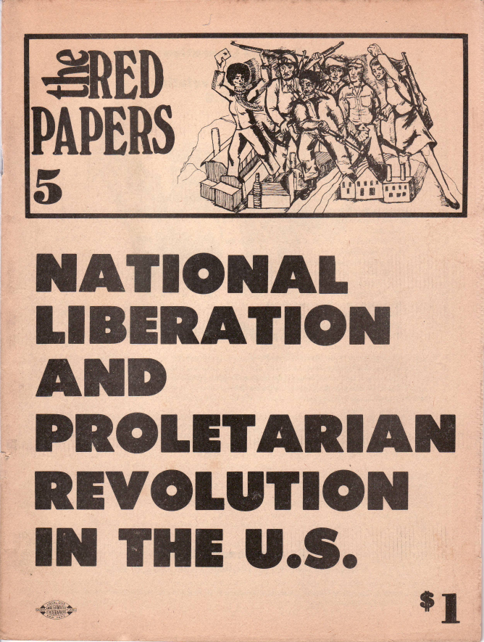
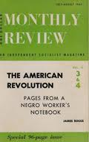
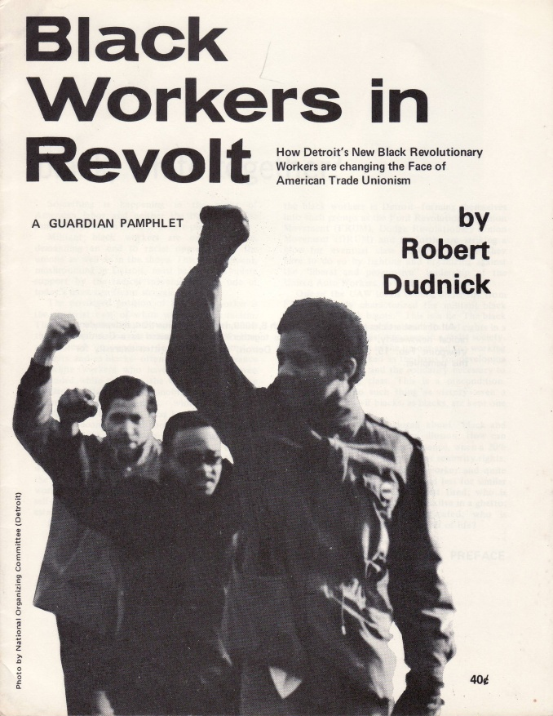

Black worker insurgency
gave rise to a rebirth of a
communist movement in
the US and a renaissance
in Marxist analysis of
Black history.

Slide 31

Toward a theory
of Black History

Slide 32
The basic questions:
What are the basic categories of
the Black (human) experience?
2. What is the role of technology
(productive forces)?
3. What is the role of class struggle?
4. What is the logic of social change
(stages of development)?
5. Does this add up to a new paradigm
for Black history?

Slide 33
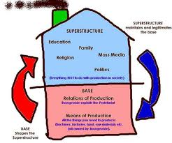
The basic categories of society
Superstructure:
Consciousness
Cultural relations
Social relations
Demography
Base:
Production relations
Production forces

Slide 34

Describing the Black subject
Superstructure:
Consciousness
Cultural relations
Social relations
Demography
Base:
Production relations
Production forces
The Black experience is usually
described in terms of how many
and where Black people are, what
kind of social and cultural life they
have and what they think.
Black people have survived based
on what work they do – this is
fundamental and defines ones
quality of life possibility.

Slide 35

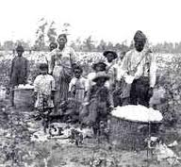
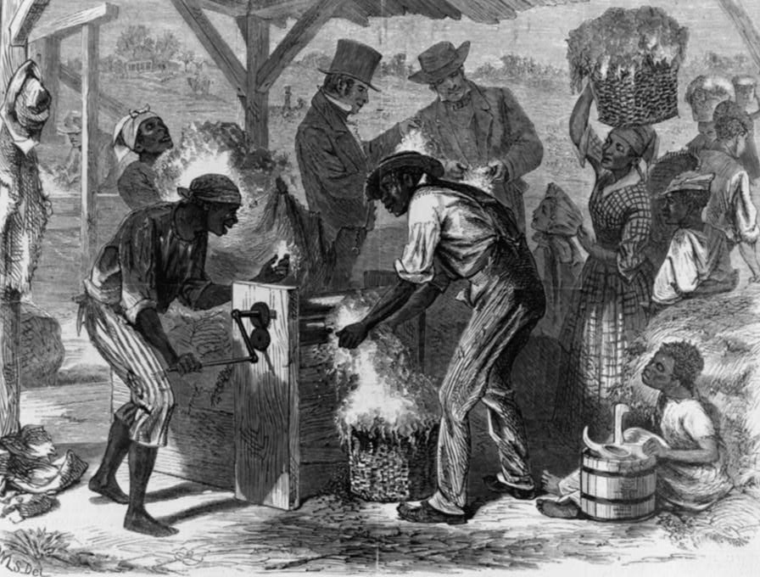
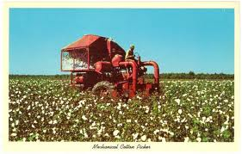
Critical technology in the Black experience
The cotton gin (1793)
increased demand for
labor, but the mechanical
cotton picker (1936)
ended it.

Slide 36
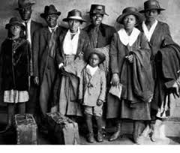

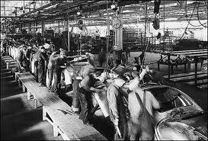
Critical technology in the Black experience
Assembly line production:
From people to robots

Slide 37
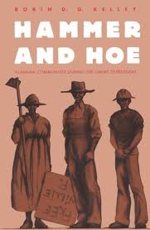
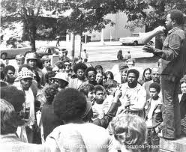
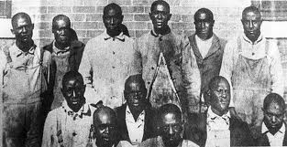

Change
comes
from the
politics
of class
struggle

Slide 38
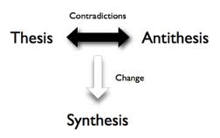
The logic is dialectical
The Black experience goes from
Modes of social cohesion
to
Modes of social disruption

Slide 39
Modes of
Social cohesion
Africa
Slavery
Rural
Urban
Information
Modes of
Social disruption
Slave trade
Emancipation
Great migrations
Crisis
The basic difference is trans-generation continuity

Slide 40
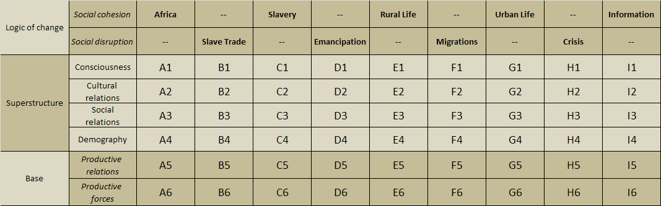
Toward a macro-theoretical model
of the African American (USA)
historical experience

Slide 41








UNESCO General History of Africa

Slide 42





The slave
trade
disrupted
every aspect
of
Black life
Eric Williams
1911 - 1981

Slide 43




246 years

Slide 44






Emancipation =
Abolition + Civil War + Reconstruction
FREEDOM!
William Llloyd Garrison
John Brown
Abigail Kelley

Slide 45


We were “free”, but being lynched,
still on our knees picking cotton!
In segregation we became an organized community!

Slide 46






Community formed

Slide 47



A push and a pull:
Black people moved North in Great Migrations
Down South was
getting rough
Up South (North)
was a little better

Slide 48


Slide 49


The city became the Black community home

Slide 50




Crisis becomes a way of Black community life

Slide 51


A revolution is underway:
The information society
What is
the nature
of the
Black Freedom
Struggle in the
21st century?
Who is computer literate?
Who has access?
Who faces the digital divide?
We mainly have questions,
not answers.

Slide 52


Texts based on the theory of historical periodization
http://www.eblackstudies.org/intro/

Slide 53

Theory and research
Macro: What are the major features of the
modes of social cohesion and social
disruption across all aspects of society?
Micro: What is the historical periodization of
every specific aspect of society?
From empirical detail to abstract concepts,
and always remember that method is key!

Slide 54

Theory and intellectual history

Slide 55
Theory and popular discourse
If this model of theory of Black history is accurate
then it is the basis for an active popular discourse in
every community church, barber shop, union hall,
or street corner.
New societies have been created, revolutions
We are living at the beginning of a new revolution.
The final question: How can we become revolutionaries and advance the freedom struggle?

Slide 56


Lets get theoretical.
Its time for vision. Lets do this!

Slide 57

Thank you for watching.
Please send comments to
H-Afro-Am@H-Net.msu.edu

